Slide 1

Online Banking Test Applications
Guided By: D. Sridhar
Project By: P . Bhargav Kumar
Reg Num:191911263
Dept : CSE

Slide 2
OBJECTIVE:
The purpose of a test case is to determine if different features within a system are performing as expected and to confirm that the system satisfies all related standards, guidelines and customer requirements. The process of writing a test case can also help reveal errors or defects within the system.
To enable bank customers to use mobile instruments as a channel for accessing their banks accounts and remit funds. Making payment simpler just with the mobile number of the beneficiary. To sub-serve the goal of Reserve Bank of India (RBI) in Electronification of retail payments.

Slide 3
ABSTRACT:
Banking applications are considered to be one of the most complex applications in todays software development and testing industry. What makes Banking application so complex? What approach should be followed in order to test the complex workflows involved? In this article we will be highlighting different stages and techniques involved in testing Banking applications.

Slide 4
PROPOSED SYSTEM:
Though there are many online systems available on internet but this can compete with them with some advancement in its functionality and can be used by any bank organization to maintain their customers account and online transaction process.
The basic functionalities of the system are:
Create Account
Login
Update Profile
Password Recovery
Update Profile
EMI and Loan calculator
Delete Account
Logout

Slide 5
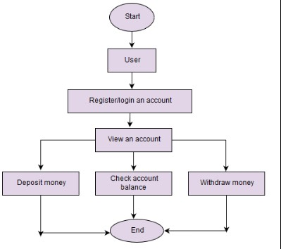
FLOW CHART:

Slide 6
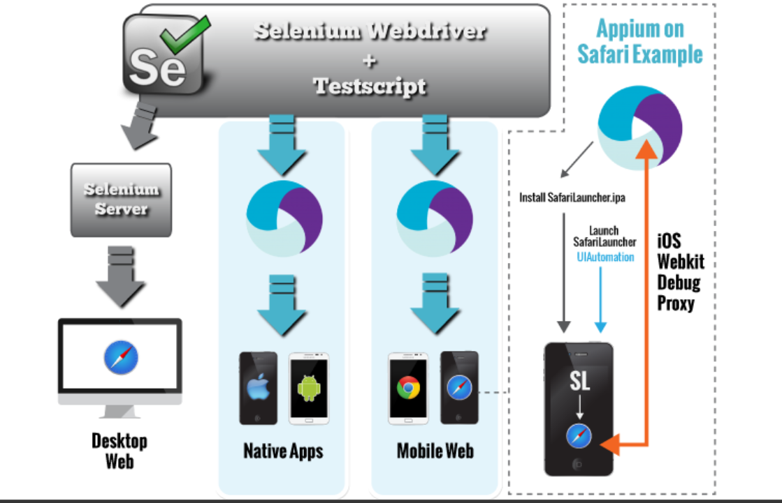
CONCEPT MAP:

Slide 7
Test cases
Checking mandatory input parameters
Checking optional input parameters
Check whether able to create account entity.
Check whether you are able to deposit an amount in the newly created account (and thus updating the balance)
Check whether you are able to withdraw an amount in the newly created account (after deposit) (and thus updating the balance)
Check whether company name and its pan number and other details are provided in case of salary account
Check whether primary account number is provided in case of secondary account
Check whether company details are provided in cases of company's current account
Check whether proofs for joint account is provided in case of joint account
Check whether you are able deposit an account in the name of either of the person in an joint

Slide 8
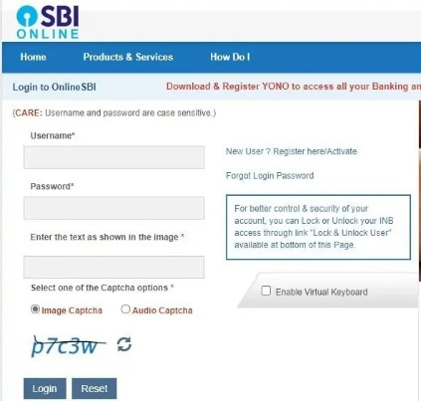
Login Portal:

Slide 9
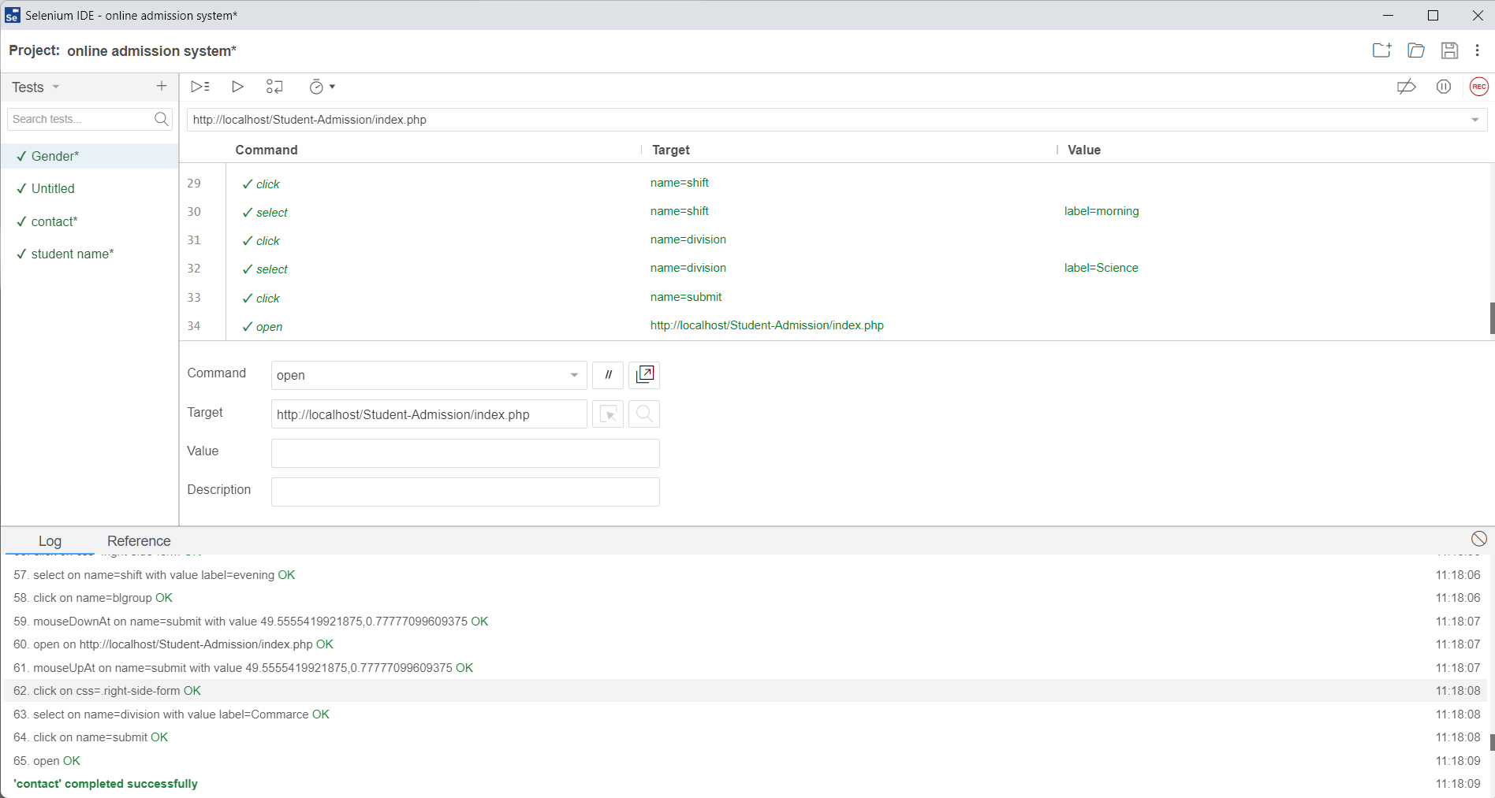
Testing the Online Banking Using IDE:

Slide 10
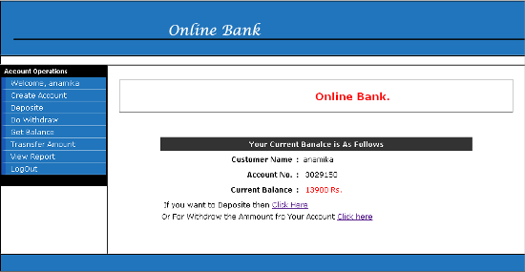
Testing Banking Application Using IDE:

Slide 11
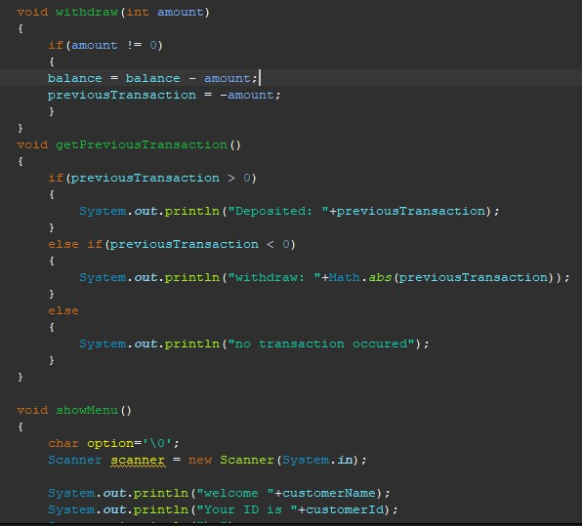
IMPLEMENTATION:

Slide 12
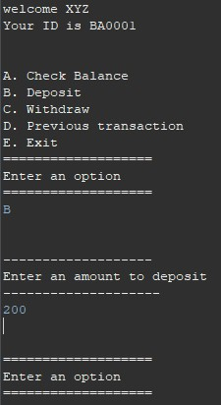
OUTPUTS:

Slide 13
TEST CASE OUTCOMES:
TEST CASE | OUTCOMES
An online account is simple to open and easy to operate. | Positive
Information may be spread out on several devices | Negative
It is fast and efficient | positive
Password security is a must | negative
You can keep an eye on your transactions | positive
server is down, then you cannot access your accounts | negative
More online services | positive
Security of transactions is a big issue | negative
It is available all the time | positive
Internet banking might be difficult at the first. | negative

Slide 14
CONCLUSION
This project was successfully completed within the time span allotted. The project online banking
has been developed in asp.net. All the modules are tested separately and put together to form the main system. Finally the system is tested with real data and everything worked successfully. Thus the system has fulfilled the entire objective identified. The system had been developed in an attractive dialogs fashion.
So user with minimum knowledge about computers can also operate the system easily. It will make easy interactions between users and store. The speed and accuracy are maintained in proper way

Slide 15


